Slide 1
Convolutional Neural Network (CNN) Basics
Tutorial
CS 5242 Neural Networks and Deep Learning
Wangbo Zhao
2024.01.05

Slide 2
Questions about Final Project
1. Form a team of 2-4 students for the final project (40%)
Each team gives a talk or presents a poster (10%)
Each team finishes a report (30%)
2. https://docs.google.com/spreadsheets/d/1qug77cwjQE3mkKeuUwU-CsjqybOdRFxvtYzGdipwiFg/edit?usp=sharing
If you have some questions about the topic selection of your project, discuss with me later.
3. Presentation Deadline：Give a presentation about your project on April 15th
Report Deadline: Send it to yang.you.cs@gmail.com before the May 1st

Slide 3
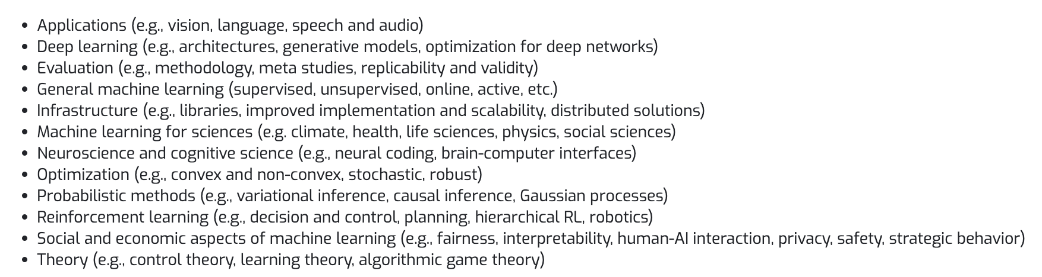
Questions about Final Project
4. Format: At most 9 pages in NeurIPS format https://nips.cc/Conferences/2020/PaperInformation/StyleFiles
5. Topic selection：Please focus on deep learning and its applications e.g. Computer Vision, and Natural Language Processing. Topics including but not limited to:

Slide 4
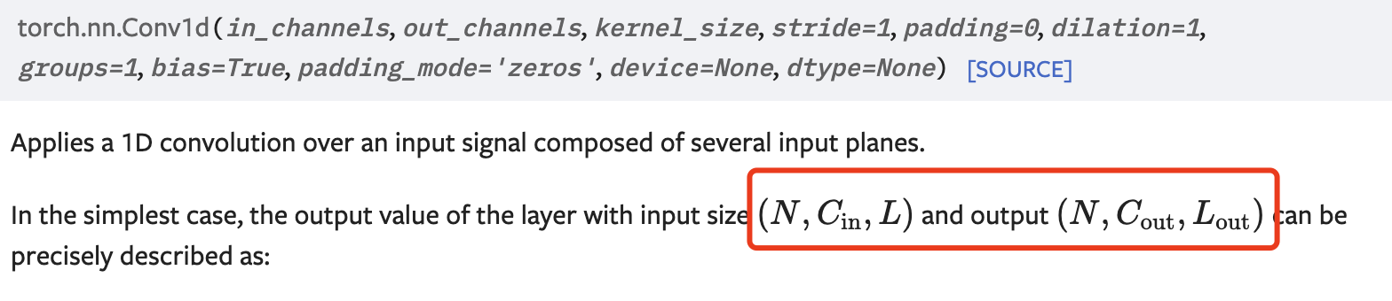
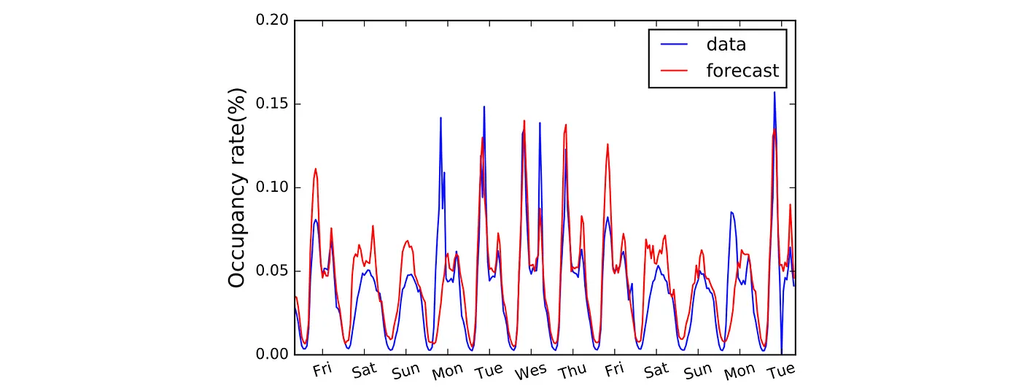
Convolutional Neural Network-Convolution
Conv1D
Application:Sequential Data
Input size:
N: batch size
C: channel size
L: the length of the sequence
traffic forcast

Slide 5
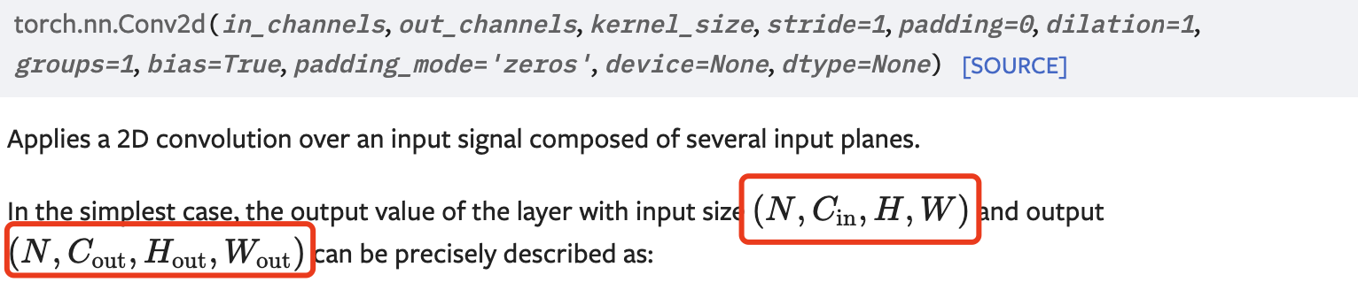
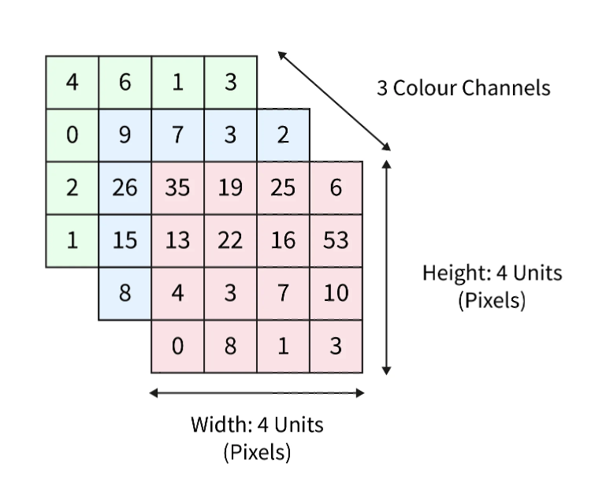
Convolutional Neural Network-Convolution
Conv2D
Application: Image data
Input size:
N: batch size
C: channel size
H: the height of the feature map
W: the width of the feature map

Slide 6
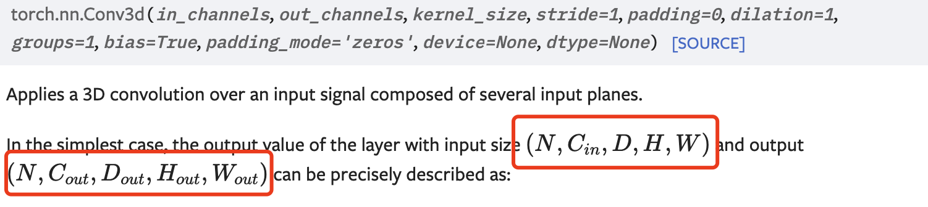
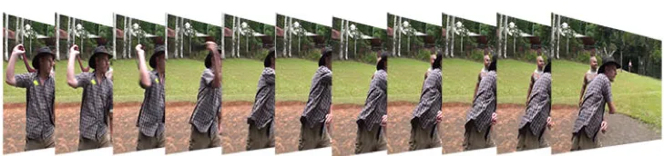
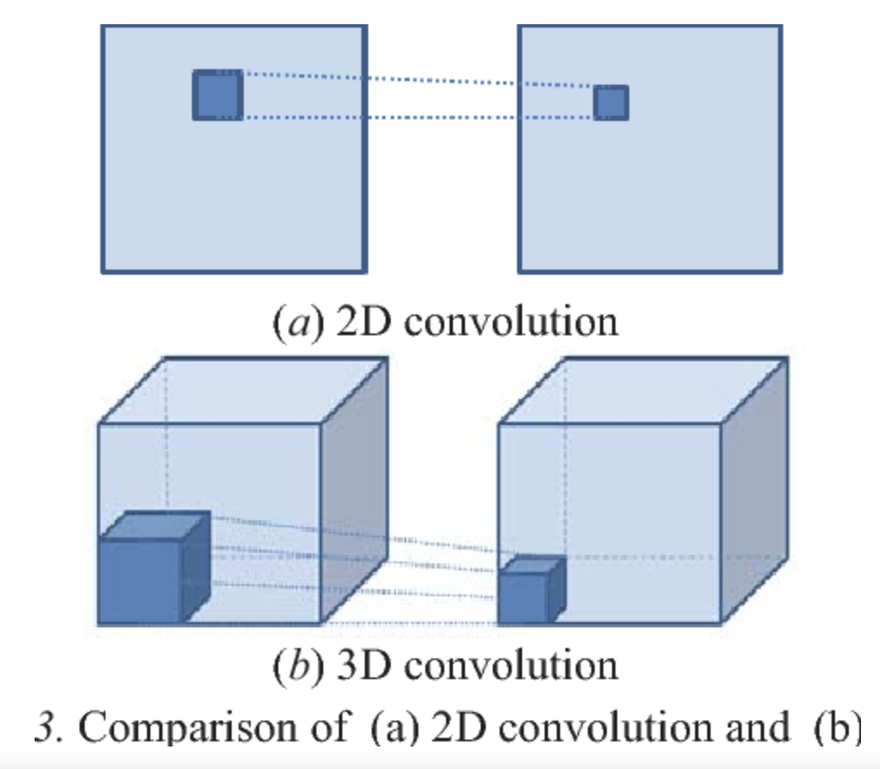
Convolutional Neural Network-Convolution
Conv3D
Application: Video data
Input size:
N: batch size
C: channel size
H: the height of the feature map
W: the width of the feature map
D: the depth of the feature map (the number of frames)

Slide 7
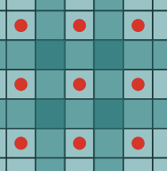
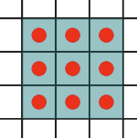
Convolutional Neural Network-Convolution
Arguments
in_channels:Number of channels in the input data
output_channels:Number of channels produced by the convolution e.g.128 256
kernel_size: Size of the convolving kernel e.g 1x1 3x3, 1, 3
stride:Stride of the convolution. Default: 1
padding:Zero-padding added to both sides of the input. Default: 0
*dilation:Spacing between kernel elements. Default: 1
*groups:Default: 1 Google: Group Conv/Depth-wise conv
kernel_size=(3, 3)
dilation=2
kernel_size=(3, 3)
dilation=1
MULTI-SCALE CONTEXT AGGREGATION BY DILATED CONVOLUTIONS,2016

Slide 8
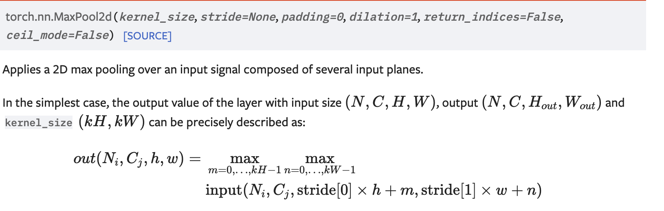
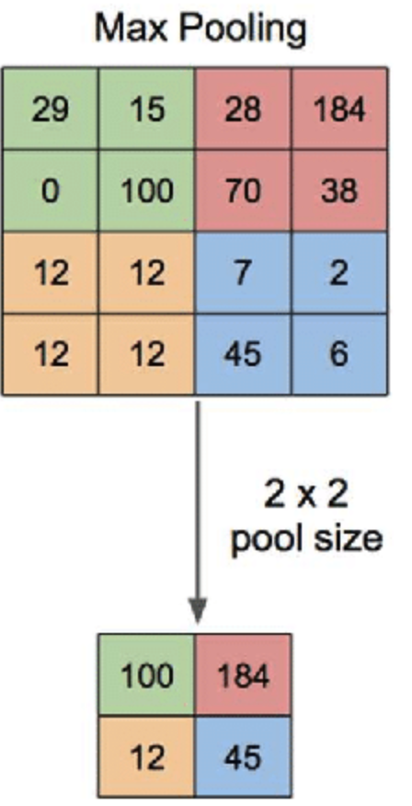
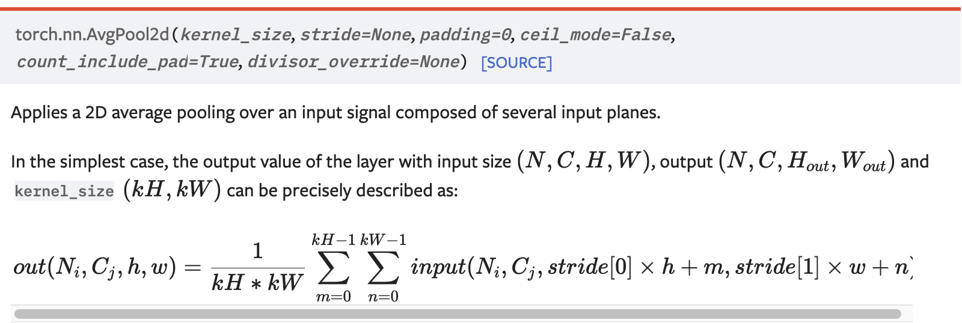
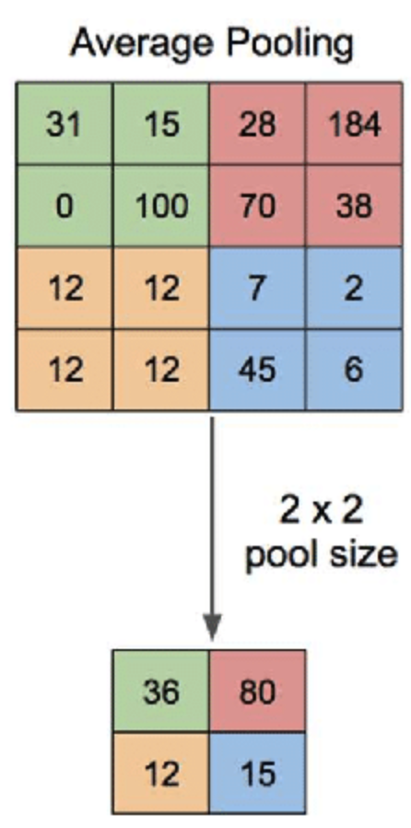
Convolutional Neural Network-Convolution
Max-Pooling
Average-Pooling

Slide 9
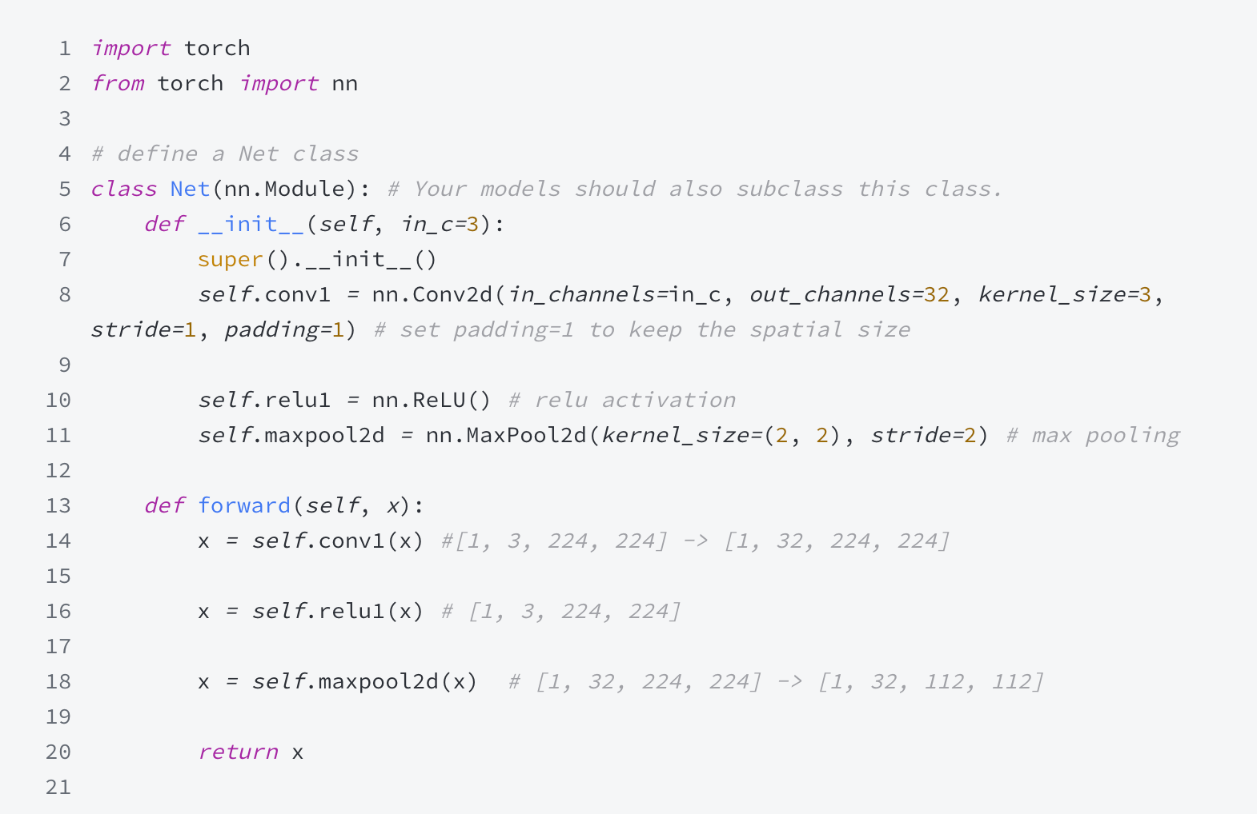
Convolutional Neural Network-Convolution
Codes

Slide 10
Thanks

